Slide 1

SparQL
Querying semantic data

Slide 2

Introduction
Overview of the Semantic Web
How interrelated datasets (linked data) work
Triples vs relations (tables)
Semantic Web Standards
RDF, OWL etc.
SPARQL Syntax
SELECT, WHERE, LIMIT, variables, etc.
Shortcuts, graphs, and unions
Querying a Semantic Website
Accessing a SPARQL Endpoint
Querying a dataset
Advanced SPARQL Constructs
FILTER, OPTIONAL, etc.
Modelling Semantic Data
URI, URL, URN, Namespace, etc.
Semantic Web standards (RDF, OWL, etc.)
Integrating SPARQL into an Application
Java libraries (Jena, etc.)
Transitioning a Website into a Semantic Web Website
Converting data into semantic data
Troubleshooting
Summary and Conclusion
Ajay Singhal : Skype: aksing1711

Slide 3
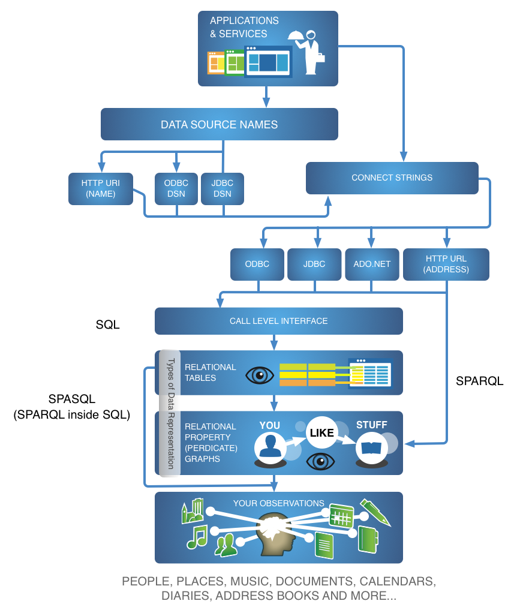
When working with data, the vital issue of Data Flow that is, the movement of data, from creation to storage, revision, and repurposing has historically been impeded by disparity along several lines, including
Data Item (i.e., Subject or Entity) Identifiers
Data Access Protocols
Data Structures
Data Locations
Data Query Languages

Slide 4
Ontology revisit

Slide 5
Ontology
A model that represents knowledge as a set of concepts within a domain and the relationships between these concepts.

Slide 6
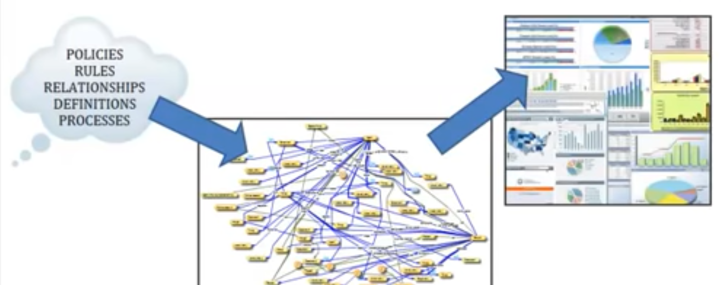
Captures knowledge within an organization as a model.
This model can be used by users to query complex questions and display relationships across an enterprise.

Slide 7
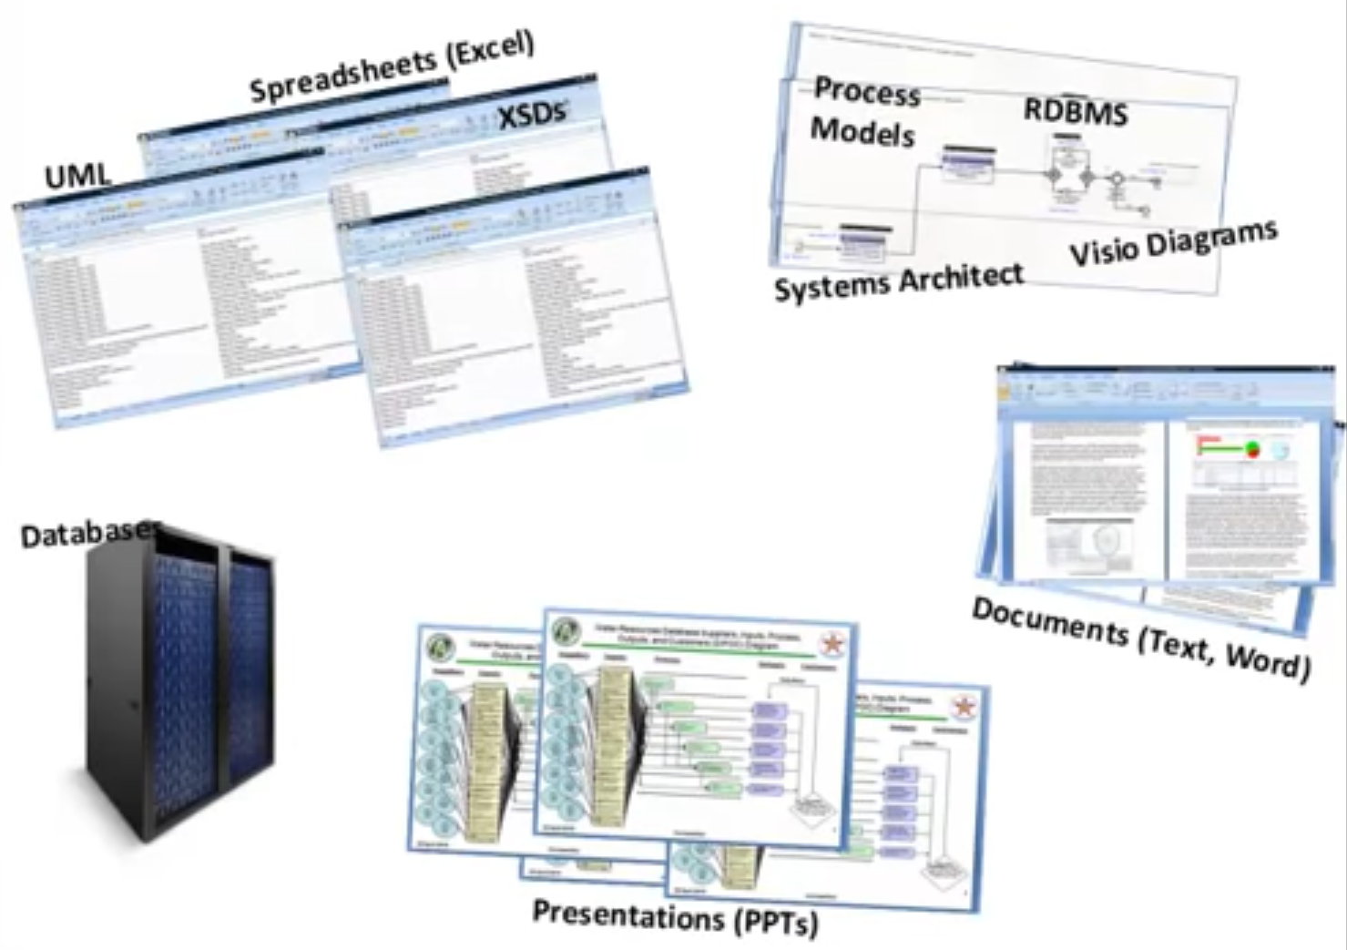
We have access to huge datasets and it exists in multiple forms/formats.
All data captured and stored in different formats makes it difficult to understand relationships between the data.

Slide 8
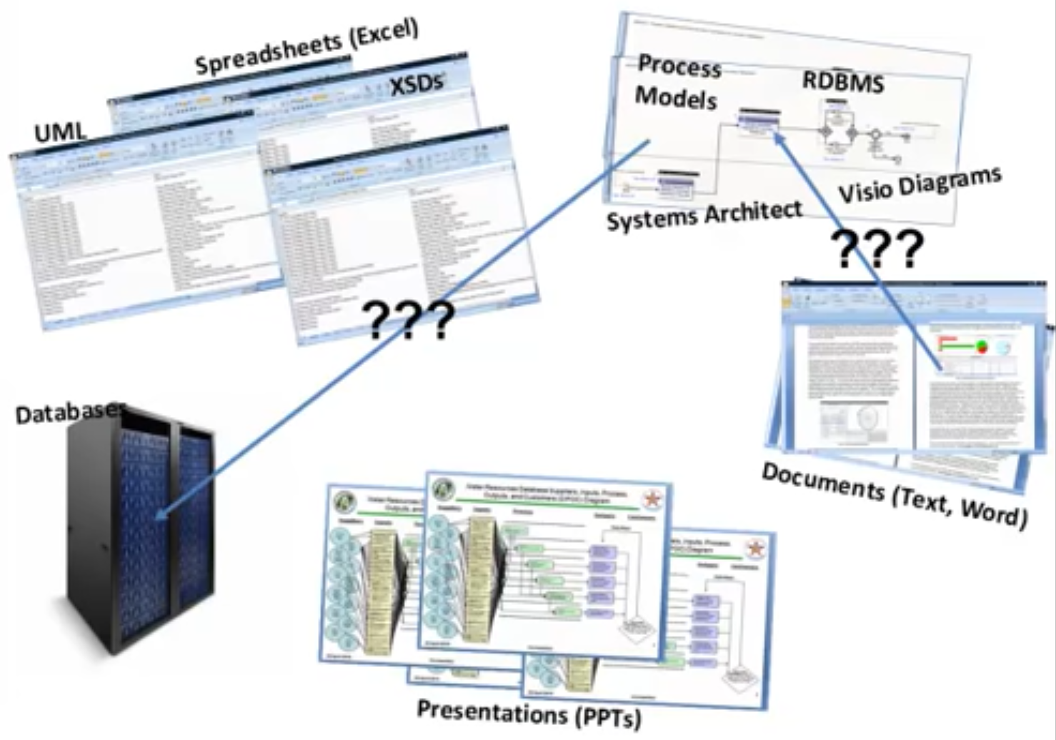
i.e. Policies in word documents relate to business processes in models and how these business processes relate to data in databases.
Data needs to be represented in format that allows these relationships to be discovered.
Ontologies capture the data in a way that allows the relationships to become visible.

Slide 9
Ontology is often considered a subset of taxonomy.
An ontology: Is a domain; contains more information about the behavior of entities and the relationships between them; includes formal names, definitions and attributes of entities; and, may be constructed using OWL, the Ontology Web Language from the W3C.

Slide 10
What others say!!
“A data model that represents a set of concepts within a domain and the relationships among those concepts.” (Microsoft)
“More complex and quite formal collection of terms.” (W3C)
“A way to represent our knowledge on a specific topic that also allows us to share information using a common language.” (NIH)
“Describe and classify the entities of interest in a scientific domain in a computationally accessible fashion such that algorithms and tools can be developed around them.” (PubMed)

Slide 11
Businesses Apply Ontologies to:
“Harmonize data across repositories in a common language for an industry.”
To share a common understanding of the structure of information among people or software agents.
To enable reuse of domain.
Understand the how the usage of a term has changed over time and thus placing a term in context.
To allow machines to apply more efficient deep learning techniques and learn better independently.

Slide 12
Ontologies factor the thinking about how a domain influences: choices of maps and models, rules and representations, and required operations. Using taxonomies, alone, just does not model this type of thinking well.

Slide 13
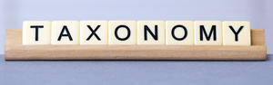
Taxonomy represents the formal structure of classes or types of objects within a domain. It organizes knowledge by using a controlled vocabulary to make it easier to find related information.
A taxonomy must:
Follow a hierarchic format and provides names for each object in relation to other objects.
May also capture the membership properties of each object in relation to other objects.
Have specific rules used to classify or categorize any object in a domain. These rules must be complete, consistent, and unambiguous.
Apply rigor in specification, ensuring any newly discovered object must fit into one and only one category or object.
Inherit all the properties of the class above it, but can also have additional properties.

Slide 14
What others say!!
“Taxonomy is a set of chosen terms use to retrieve on-line content – to make the search and browse capabilities of the content, document or records management systems truly functional.” (Computer Weekly)
“Taxonomy is a Knowledge Organization System (KOS) or a set of elements, often structured and controlled, which can be used for describing (indexing) objects, browsing collections etc.” (W3C org)
“Taxonomy is a classification of products.” (Forbes)
“Taxonomy is a curated classification and nomenclature for all of the organisms in the public sequence database.” (NCBI)

Slide 15
Businesses Apply Taxonomies to:
Achieve better Data Quality.
Organize metadata in an easy grasp format (e.g. a Website map).
Manage data assets through Data Governance.
Make it easier for a data steward to curate information.
Guide machine learning and data experiences towards identifying trends and patterns.
Finding a book or document in a library or a specific website in a browser like Google, requires taxonomies, as does using a thesaurus.
Notes:
While Taxonomies may differ across domains or Ontologies, they remain consistent in a specific representation (e.g. a business, department, or subject area)

Slide 16
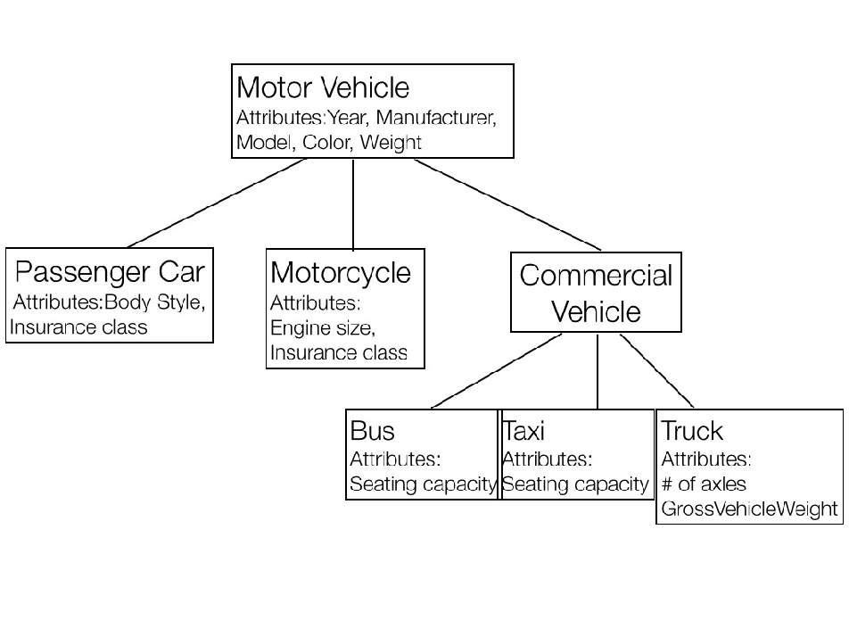
Sample Taxonomy

Slide 17
Ontologies are made up of classes relationships

Slide 18
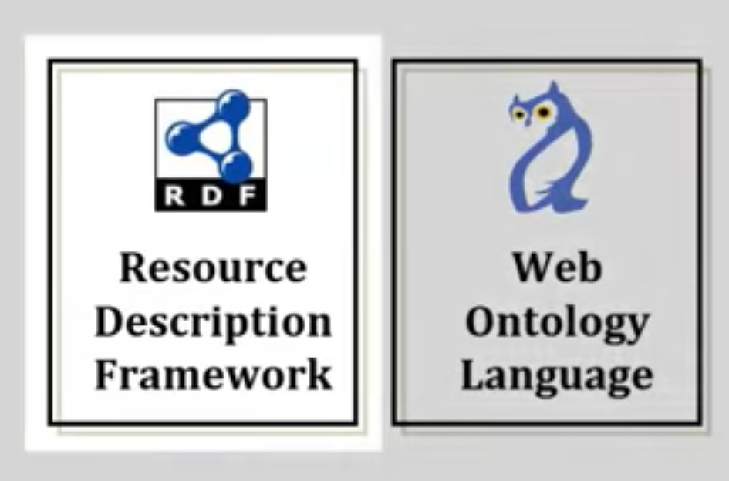
Two standards which govern the construction of Ontologies are
RDF : Resource Description framework
OWL: Web Ontology Language

Slide 19
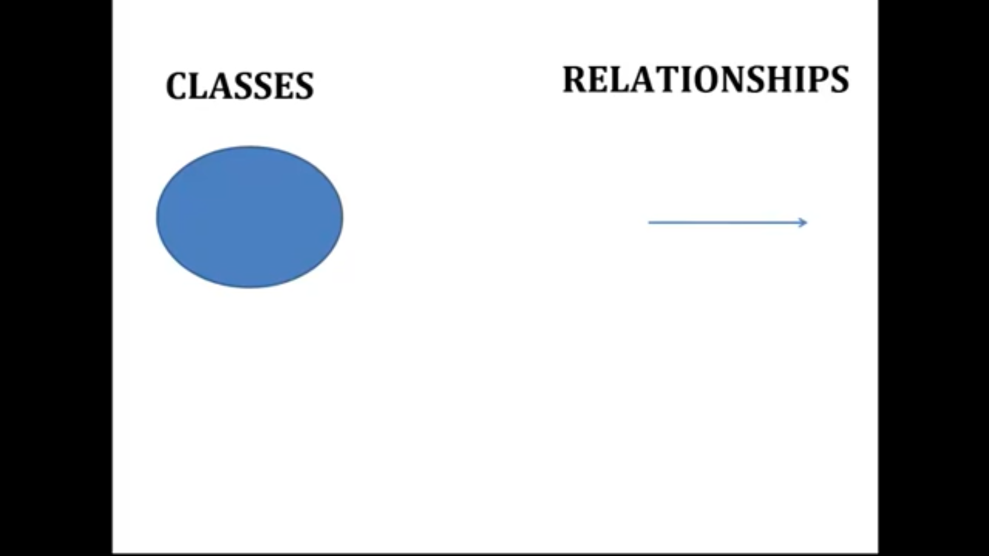
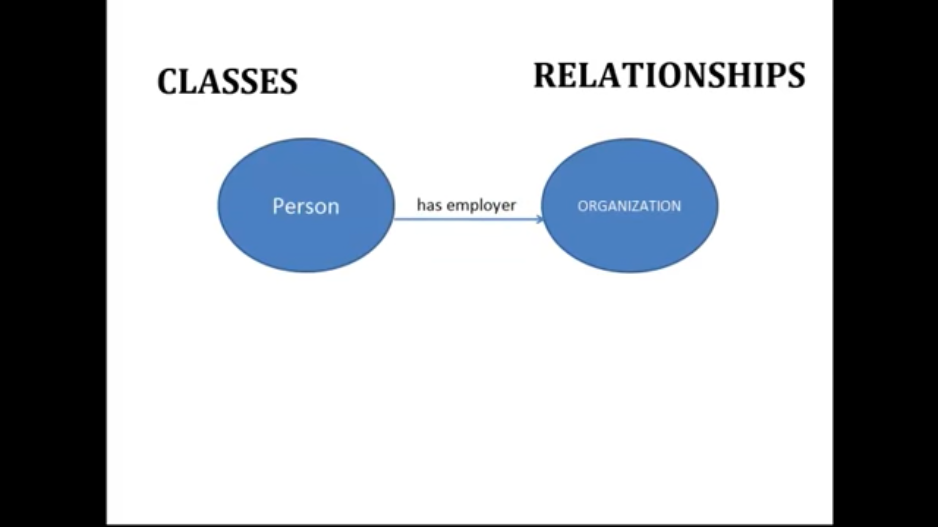
Ontologies are made up of 2 main components :
Each class represents a real world concept.
Classes & relationships can be combined to assert statements about real world.
Ontologies can be used to describe real world relationships.

Slide 20
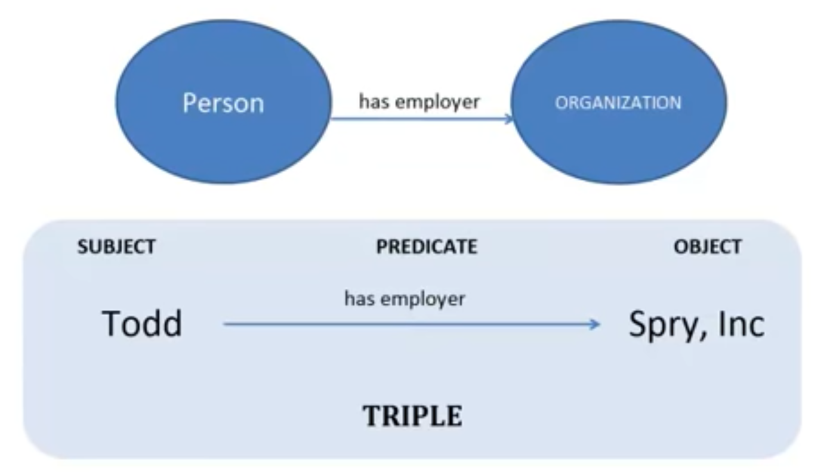
Todd: an instance of class person
Spry, INC an instance of class organization .
Combination of classes & relationships is known as TRIPLE.
Triples lay at heart of ontologies and can be merged together to provide a comprehensive view of real world within a ontology.

Slide 21
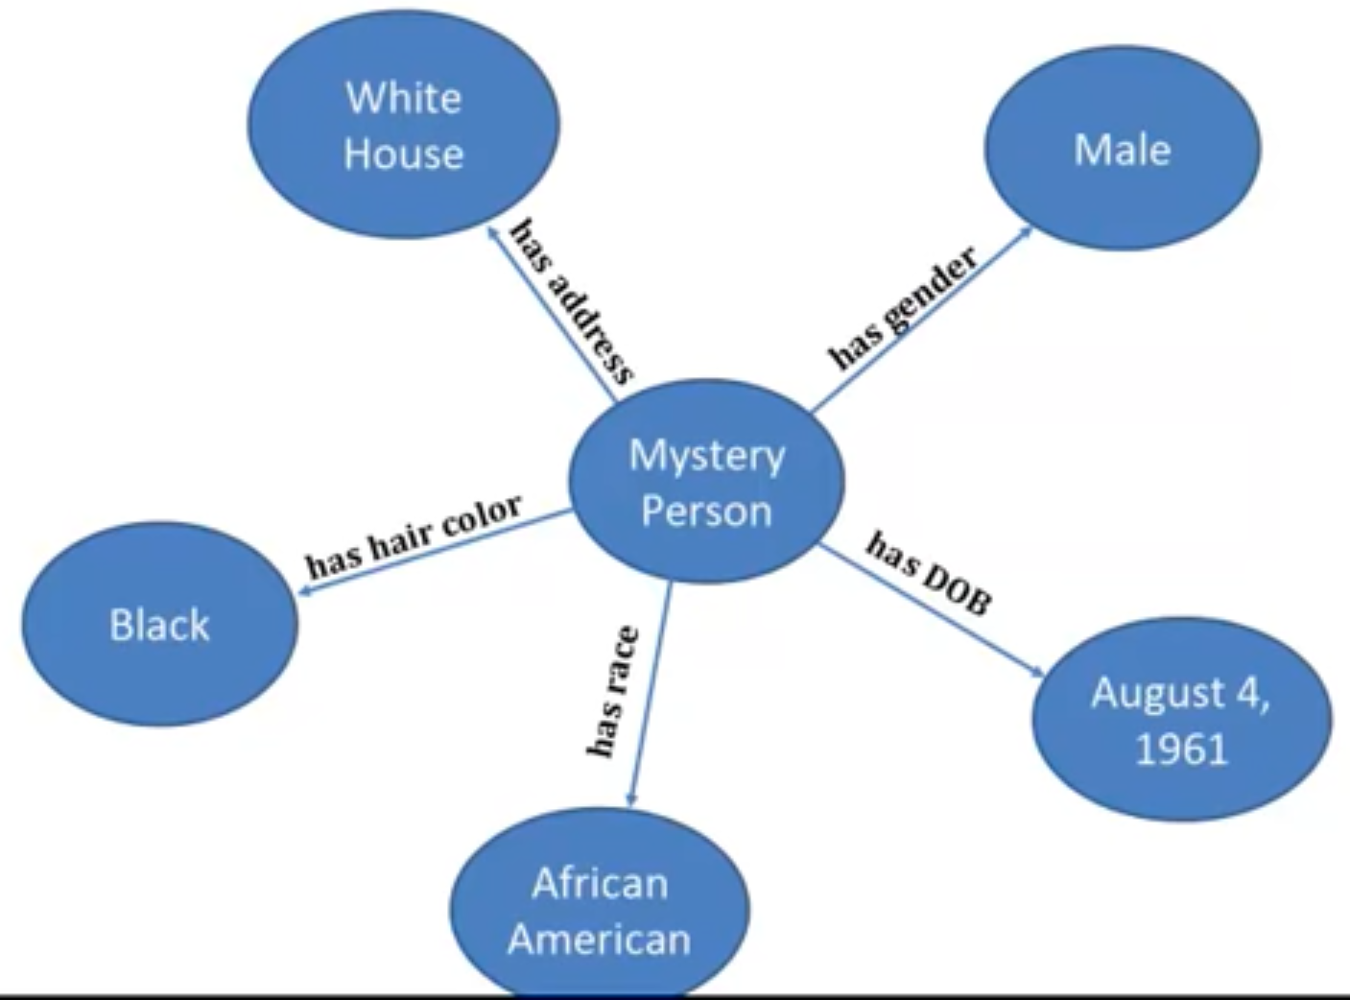
Within an ontology concepts are only defined in terms of relationship to other concepts.
Example: Describing a concept called “Mystery Person”
This has many relationships to other concepts
Gender
DOB
Race
Hair color
Address
Notes:
Ontologies through RDF and OWL are designed and structured to capture such relationships.

Slide 22
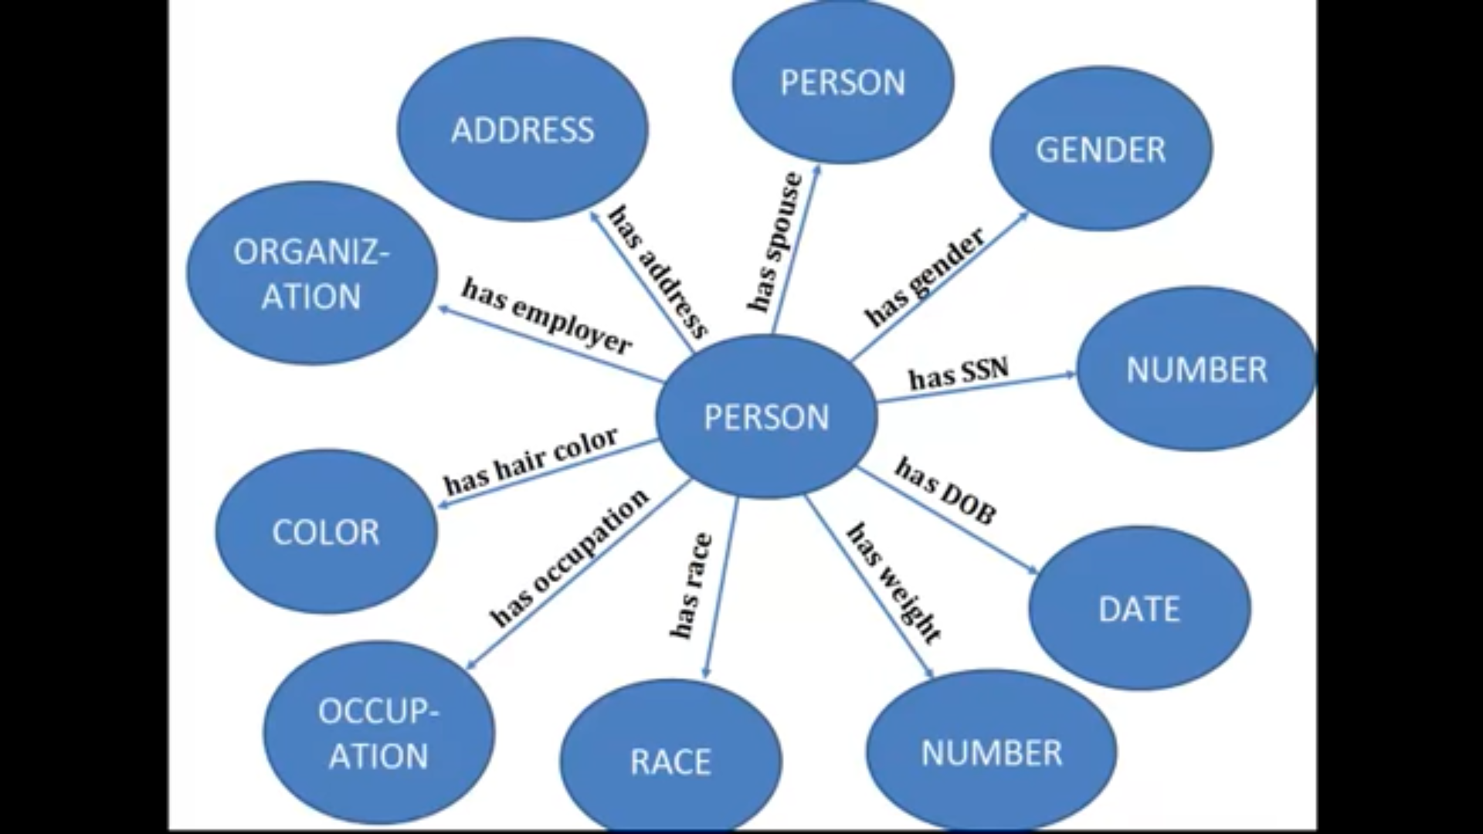
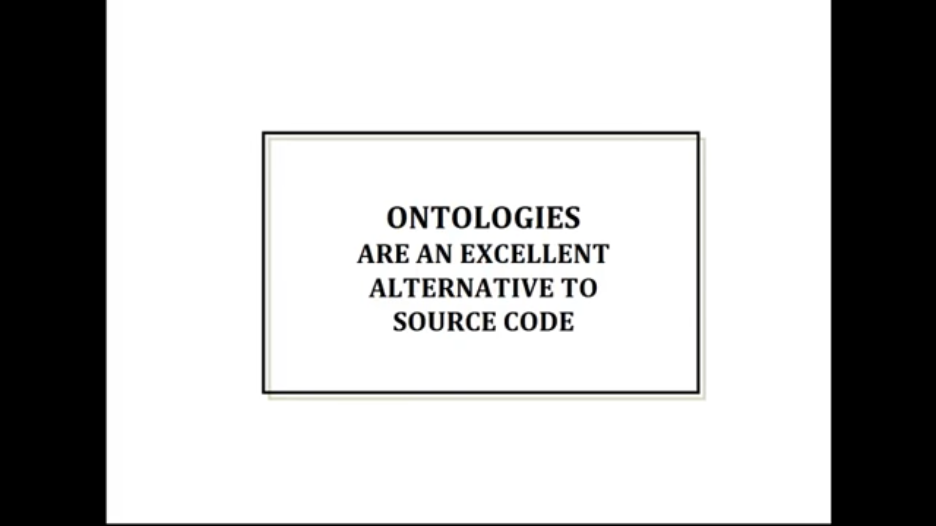
Ontologies are extensible and allow adding new relationships to existing relationships.
Notes:
One of popular concepts of ontologies wrt additionally capturing relationships is that using ontologies for knowledge management is an alternative to source code.

Slide 23
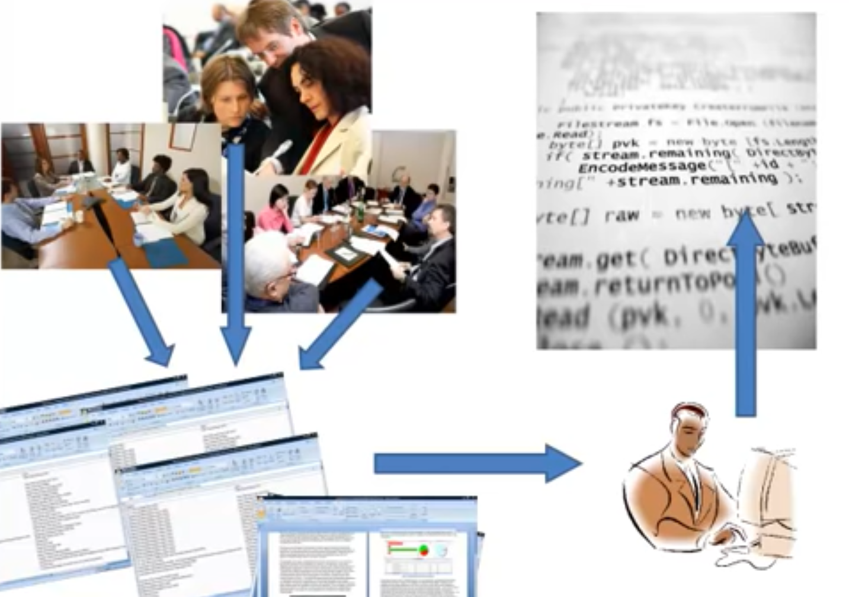
Many approaches capture knowledge in relationships ,established by different working groups and lead to huge source code.
This approach
Is extremely hard to manage
Can be managed by small group of engineers
Not easily adaptable to changes in environment

Slide 24
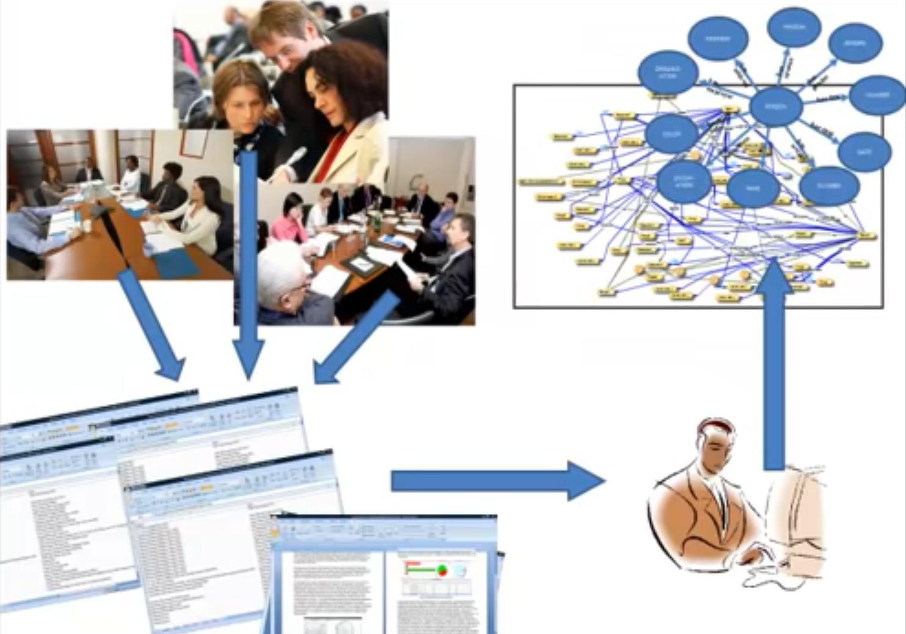
Ontologies bring a new method in managing knowledge and capturing relationships.
Using models instead of codes allows adaptability

Slide 25
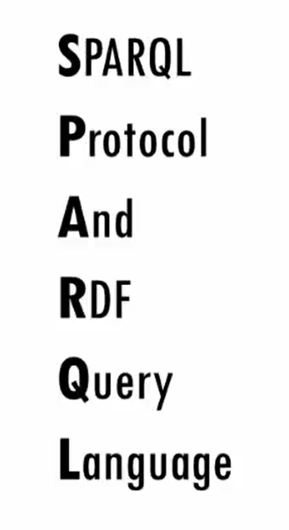
Notes:
Sparql is a w3c standard it stands for Sparql protocol and RDF query language.
the protocol part is usually only an issue for people writing programs that pass sparql queries back and forth between different machines ,for most people sparkql’s greatest value is as a
query language for rdf (resource description framework) another w3c standard.

Slide 26
Every SPARQL Query has a Solution Modifier (or head) and a Query Body.
The Solution Modifier provides the basis for categorizing different types of SPARQL Query solutions.
The Query Body comprises a collection of RDF statement patterns (represented using Turtle Notation) that represent the entity relationships to which a query is scoped.

Slide 27
Read Oriented Query Types

Slide 28
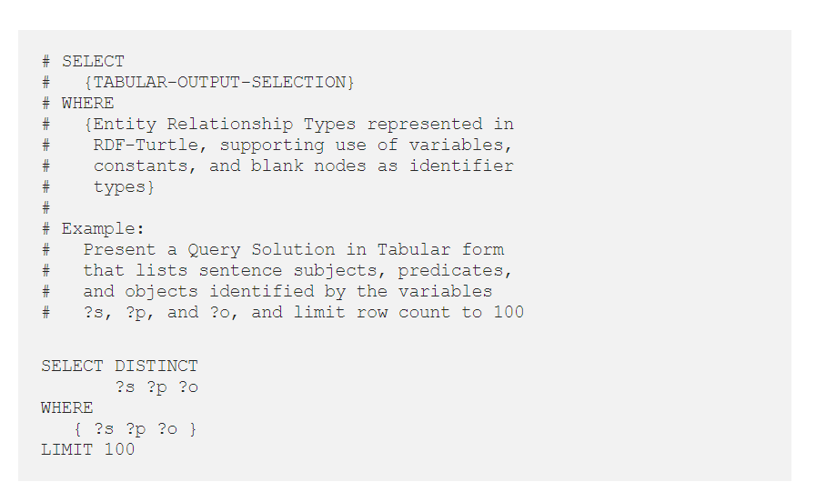
SELECT — the Solution Modifier takes the form of a SELECT list, which is very much like a SQL SELECT list, that projects a query solution in tabular form

Slide 29
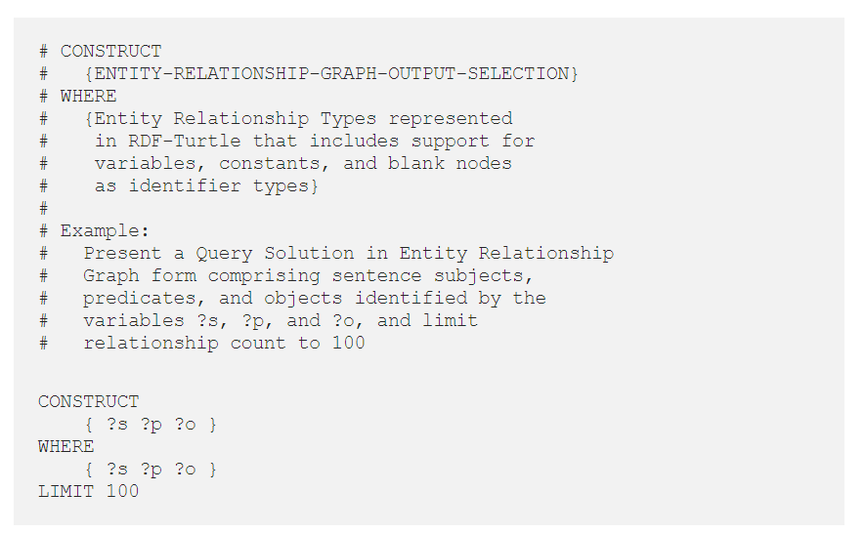
CONSTRUCT — the Solution Modifier takes the form of an RDF sentence/statement graph specification

Slide 30

DESCRIBE — a variant of CONSTRUCT where the Solution Modifier takes the form of an RDF sentence/statement graph specification that describes a selection of entities

Slide 31
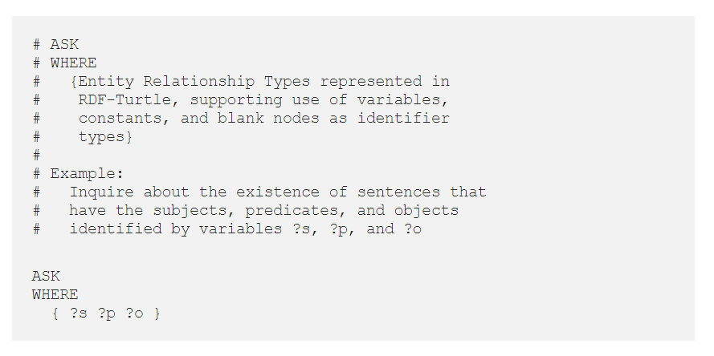
ASK — this type of query returns a simple boolean (Yes or No) query solution

Slide 32
Write Oriented Query Types

Slide 33
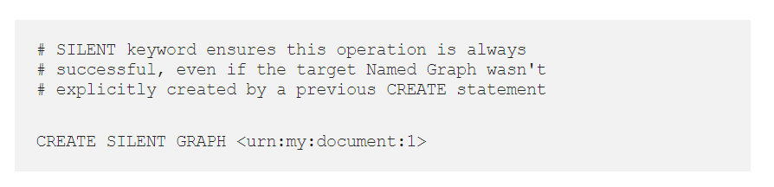
CREATE — creates a new empty Named Graph.

Slide 34

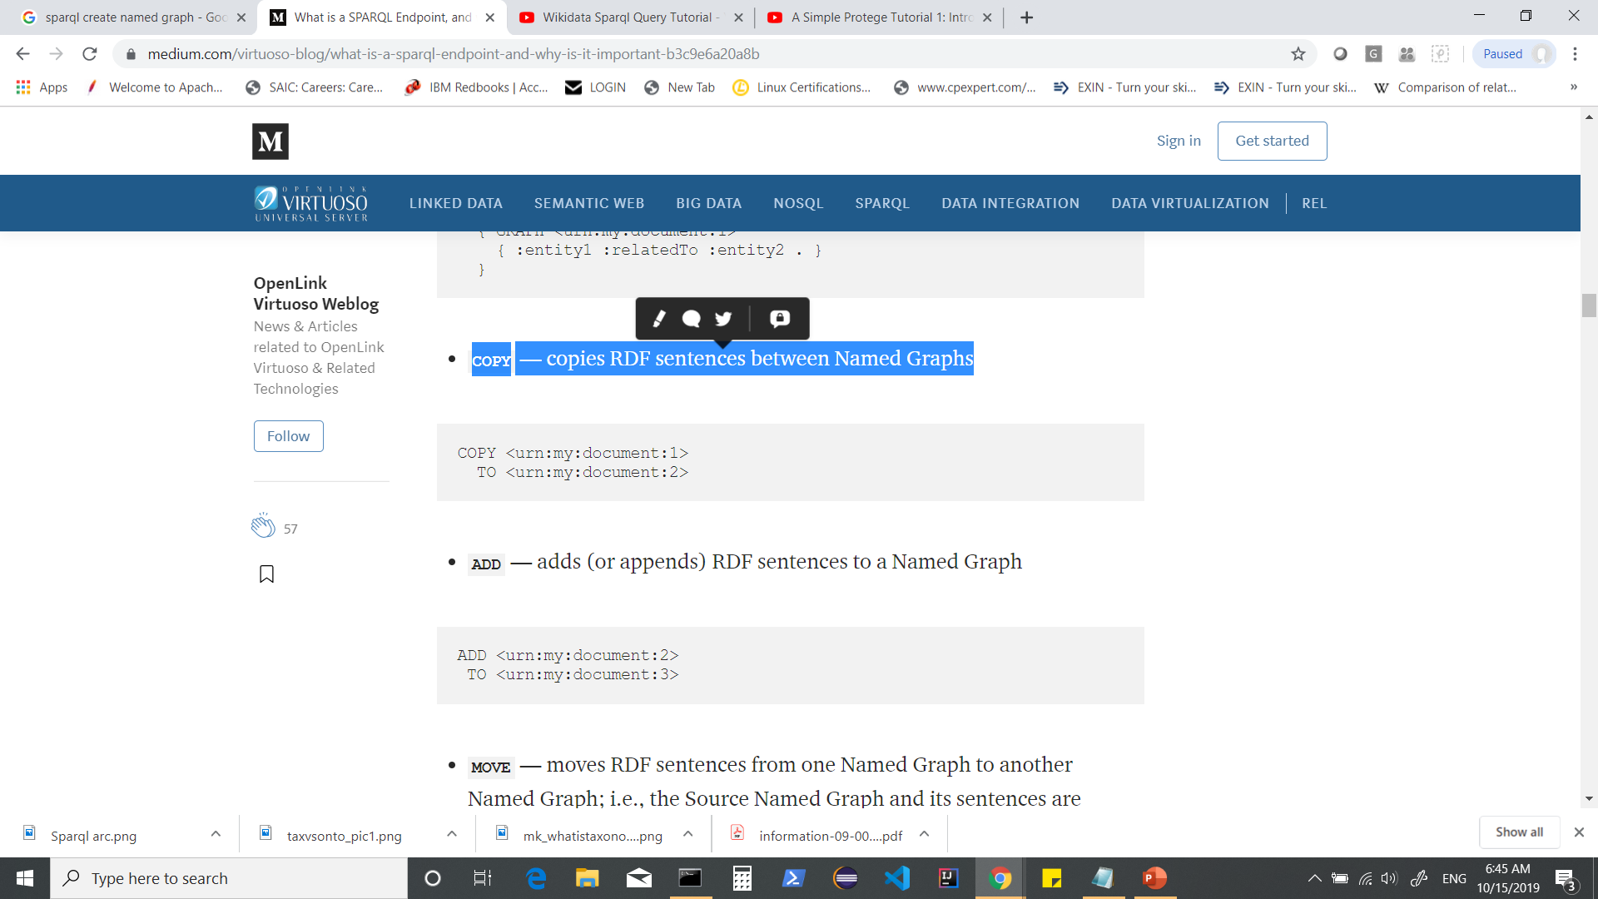
INSERT — adds RDF sentences to a Named Graph explicitly or based on conditions satisfied in the SPARQL Query body
COPY — copies RDF sentences between Named Graphs

Slide 35

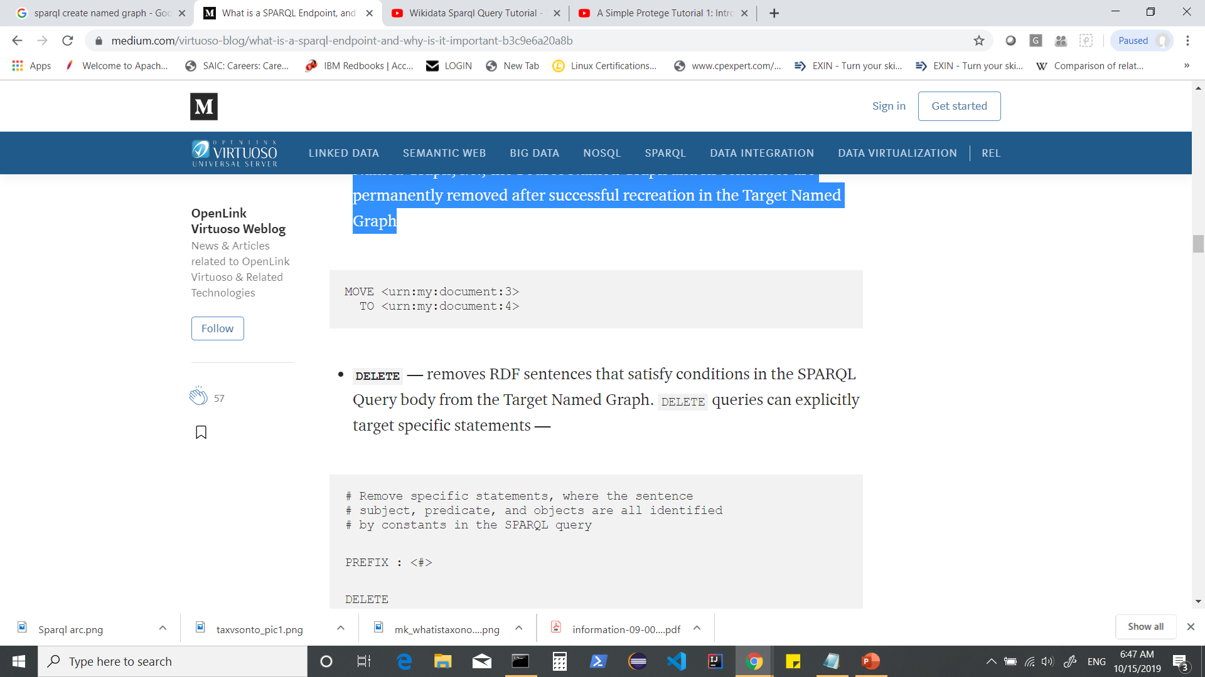
ADD — adds (or appends) RDF sentences to a Named Graph
MOVE — moves RDF sentences from one Named Graph to another Named Graph; i.e., the Source Named Graph and its sentences are permanently removed after successful recreation in the Target Named Graph

Slide 36
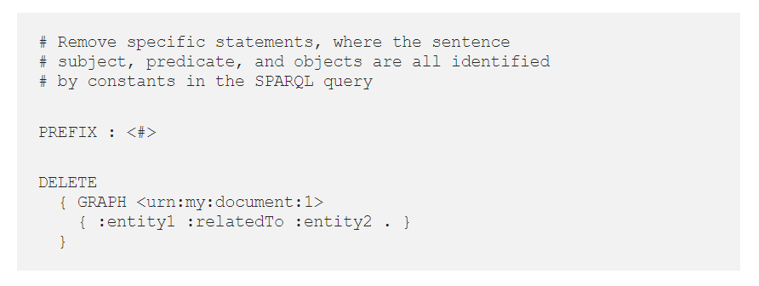
DELETE — removes RDF sentences that satisfy conditions in the SPARQL Query body from the Target Named Graph. DELETE queries can explicitly target specific statements or target whatever statements satisfy a pattern built with variables

Slide 37
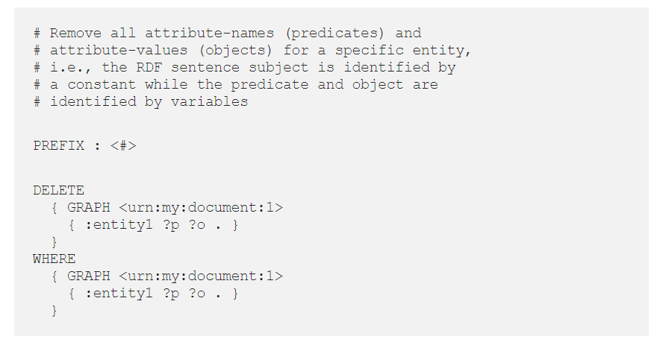

Slide 38
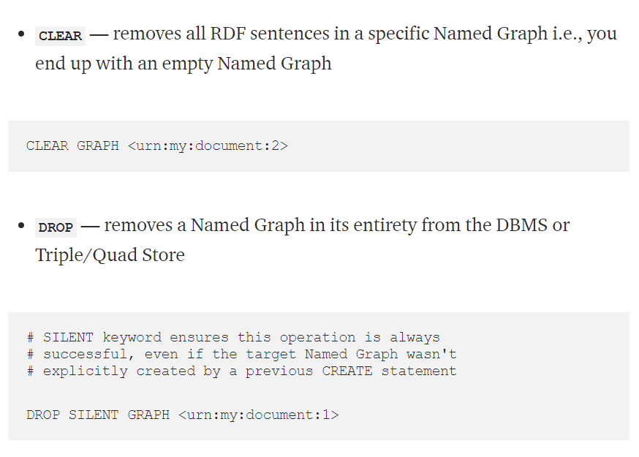

Slide 39
SparQL Terminologies

Slide 40
SPARQL Endpoint
It is a Point of Presence on an HTTP network that’s capable of receiving and processing SPARQL Protocol requests. It is identified by a URL commonly referred to as a SPARQL Endpoint URL.
SPARQL Protocol
The SPARQL Protocol is an HTTP-based protocol for performing SPARQL operations against data via SPARQL Endpoints. Subject to the kind of operation being performed, HTTP payloads are dispatched using GET, POST, or PATCH methods.

Slide 41
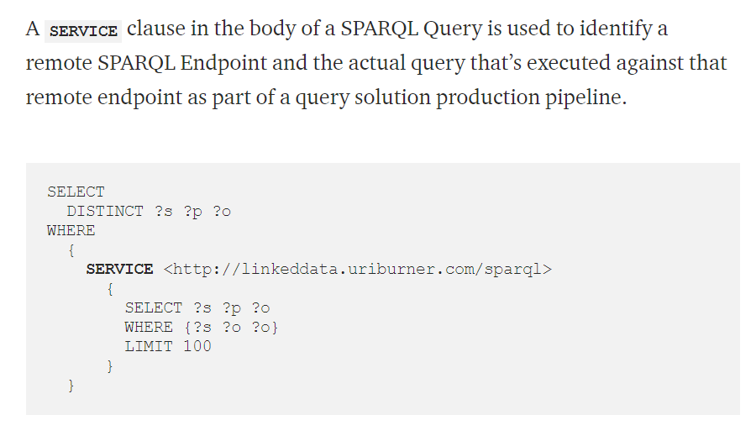
Federated SPARQL
Federated SPARQL, (also referred to as SPARQL-FED), is the federated form of a SPARQL Query that provides access to RDF statements/sentences (data) provided by remote SPARQL Query Service endpoints.

Slide 42
SPARQL Query Result Serialization Formats are a variety of document content types associated with SPARQL Query solutions. Some Query Types limit the possible Serialization Formats in which their Results may be delivered.
Among others, these include
text/html — SELECT Queries
application/sparql-results+xml — SELECT Queries
application/sparql-results+json — SELECT Queries
text/turtle — CONSTRUCT & DESCRIBE Queries
application/n-triples — CONSTRUCT & DESCRIBE Queries
text/plain — CONSTRUCT & DESCRIBE Queries
application/ld+json — CONSTRUCT & DESCRIBE Queries
application/rdf+xml — CONSTRUCT & DESCRIBE Queries

Slide 43
SPARQL Query Service
A SPARQL Query Service is an HTTP Service (also known as a Web Service) that offers an API for performing Declarative Data Definition and Data Manipulation operations on data represented as RDF sentence collections. Service is usually provided by a (DBMS) or Triple/Quad Store associated with a URL that identifies its point of presence on an HTTP network.
SPARQL Query Service : HTML-based Query Editor
A SPARQL endpoint is paired with an HTML document that functions as a simple interface for query editing and execution.
By convention, the URL of this kind of document includes the literal sparql as the final path component or as the host part of a web site’s canonical name.

Slide 44
HTML-based Query Editors
http://linkeddata.uriburner.com/sparql — URIBurner Service for “on the fly” Linked Data Generation from a myriad of Data Sources and APIs
http://lod.openlinksw.com/sparql — Linked Open Data Cloud (or LOD Cloud) Cache
http://dbpedia.org/sparql — DBpedia (nucleus of the LOD Cloud)
http://sparql.uniprot.org/ — Uniprot (Bleeding-edge KnowledgeGraph for Bioinformatics)
https://sparql.nextprot.org — neXtProt (Bleeding-edge KnowledgeGraph for Bioinformatics)
https://sparql.rhea-db.org/sparql — Rhea reactions data (Bleeding-edge KnowledgeGraph for Bioinformatics)
https://sparql.orthodb.org — OrthoDB genetics data (Bleeding-edge KnowledgeGraph for Bioinformatics)
https://sparql.omabrowser.org/sparql — OMA (“Orthologous MAtrix”) genomics data (Bleeding-edge KnowledgeGraph for Bioinformatics)

Slide 45
SELECT DISTINCT ?s3 AS ?appLabel ?s7 AS ?versionLabel ?s1 AS ?executableUri ?s4 AS ?formatLabel ?s6 AS ?OSUri ?s8 AS ?OSLabel ?s2 AS ?downloadUrl FROM <urn:data:openlink:products> WHERE { ?s1 a ?s9 . ?s1 <http://schema.org/downloadUrl> ?s2 . ?s1 <http://schema.org/name> ?s3 . ?s1 <http://purl.org/dc/terms/format> ?s4 . ?s1 <http://schema.org/name> ?s5 . ?s1 <http://www.openlinksw.com/ontology/software#hasOperatingSystemFamily> ?s6 . # FILTER ( ?s6 = <http://www.openlinksw.com/ontology/software#GenericLinux> ) . ?s1 <http://www.openlinksw.com/ontology/products#versionText> ?s7 . ?s6 schema:name ?s8 . FILTER ( ?s9 IN ( <http://www.openlinksw.com/ontology/installers#ExecutableArchive> , <http://www.openlinksw.com/ontology/installers#InitializationFile> ) ) } ORDER BY 5 1
A query is delivered to an endpoint via a HTTP request. The server associated with the endpoint returns a query solution via an HTTP response that includes a document URL.

Slide 46
SPARQL Queries are executable directly from your computer’s operating system via curl — a generic HTTP command invocation utility.

Slide 47
Get output as JSON
QUERY=$(<sample-query.sparql) && curl -X POST -H "Accept:application/sparql-results+json" --data-urlencode "query=$QUERY" http://linkeddata.uriburner.com/sparql
Get output as HTML
QUERY=$(<sample-query.sparql) && curl -X POST -H "Accept:text/html" --data-urlencode "query=$QUERY" http://linkeddata.uriburner.com/sparql
Get output as CSV
QUERY=$(<sample-query.sparql) && curl -X POST -H "Accept:text/csv" --data-urlencode "query=$QUERY" http://linkeddata.uriburner.com/sparql

Slide 48
Benefits of a SPARQL Endpoint
A SPARQL endpoint offer several unique benefits via an API:
Declarative data interaction (manipulation and definition) may be integrated via HTTP — targeting data represented as fine-grained RDF sentence/statement collections
HTTP document URLs bring extensive flexibility to data queries, i.e., each component of a URL is a slot for parameterized alteration of the specifics of a query that extends from its target endpoint to the nature of the query solution
A wide variety of content types are supported for query solution documents — HTML, JSON, CSV, RDF-Turtle, RDF-N-Triples, RDF-XML, and others
Content types of all query solution documents are negotiable — courtesy of HTTP content-negotiation (“con-neg”)
Endpoints may be accessed with any HTTP-compliant user agent or service

